Slide 1




AI Research
F24-3 Sprint Demo
`
© Conestoga College. All rights reserved.

Slide 2

Team
Copilot Studio | Tech
Arsh Chauhan | Hamna Ashraf
Paras Rupani | Wei-Hsiang Chen
 | Jongeon Lee

Slide 3

Sprint Goal
Enhancing Chatbot responses by implementing Langchain RAG pipeline
Normalizing Instructional Plan and Course Outline Data
Researching React and Exploring Next Steps

Slide 4
Demo time
CourseGPT - Smart chatbot that assists students by answering questions related to their enrolled courses and instructional plans.
How CourseGPT can help:
Instead of manually searching information for every course, students can save time asking our chatbot.
Help reduce the number of recurring emails that instructors receive regarding the information already provided in instructional plans.
The chatbot helps students keep track of assignments, quizzes, and other important deadlines.

Slide 5
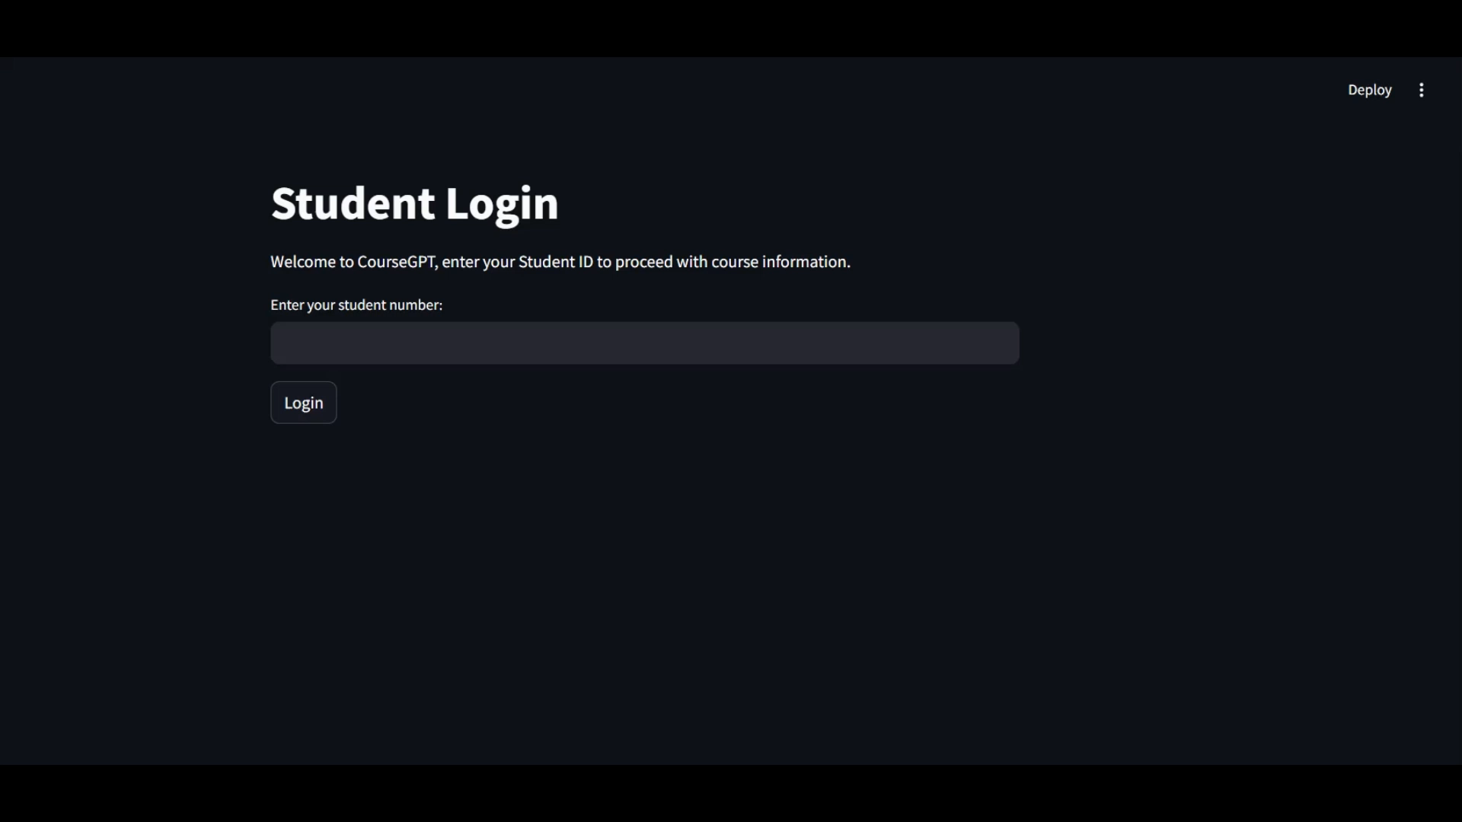

Slide 6
Blockers
Took too long to figure out which embedding technique and model works the best for our usecase.
There were errors due to the version conflicts for langchain libraries. Resolved it by updating all the packages to the latest version.
For few queries, there is an error that occurs showing problem with the document retrieval. We are looking into ways to fix it
Limited Studio Licenses:
No full access to Copilot Studio licenses.
Decided to use OpenAI embeddings and Ollama model which gave the most accurate and best results.

Slide 7
Next Plan
There were new high priority tasks added in this sprint after a discussion with Sean.
Our team plans to continue working on those tasks.
Front-end : React instead of streamlit

Slide 8
Q & A

